Slide 1
Hatch Beauchamp Parish Council
A358 Consultation Briefing
10 November 2021

Slide 2
A358 Consultation – have your say
The consultation closes 22 November at 11.59pm

Slide 3
Response Answers
Employment
Housing
Capacity
Resilience
Safety
Connectivity
Environment
Severance
Quality of Life

Slide 4
Employment
Nexus 25 – (Blackbrook has large development plot & vacant units)
Taunton to become more attractive place to work – (Taunton-centric)
Facilitate growth in Somerset and South-West – (evidence?)

Slide 5
Housing
Developers to provide housing at key hotspots along the corrider

Slide 6
Capacity
Will provide relief to the traffic congestion in Henlade (only here)
It would allow mile-a-minute travel as norm (totally misleading as they have admitted not possible due to need to slow down at either end!)

Slide 7
Resilience
Offers connection between new A358, Nexus 25 and Junction 25 (existing road does this)
Helping reduce congestion between West Hatch and M5 (ignores Southfields issue)

Slide 8
Safety
Making journeys safer by avoiding conflicting traffic-turning movements (A358 accident rate is well below national average)
Will encourage road users to use new A358 rather than local routes into Taunton (ignores local traffic and again Taunton-centric)
Provision for WCH would be enhanced & improved (disputed)

Slide 9
Connectivity
South-West/South-East connection improved (shaving a couple of minutes off journey time on this road won’t impact on travel decision)
Commuting into Taunton safer and more reliable (‘safer’ than what? All arguments biased towards Taunton)

Slide 10
Environment
Avoids Ancient Woodland at Huish Copse and at Stoke Wood (but destroys it eventually due to emissions’ deposits)
Removes the need to impact the open space (proposals are excessive in scale and involve unnecessary land grab thereby increasing environmental impact)

Slide 11
Severance
Will provide safer replacement routes for local communities (totally misleading as local vehicles will be funneled through villages and lanes in conflict with riders, walkers, pedestrians etc)
Existing WCH provision would also be enhanced and improved (disputed)

Slide 12
Quality of Life
Will allow A378 to connect to A358 improving local journeys into Taunton (this connection already exists and it is the Henlade bypass that will improve journeys not this junction)
Would cause less disruption to existing patterns of movement for local communities (total fabrication as local journeys would increase considerably both in length and duration)
Reduction in traffic congestion at Henlade would improve residents’ quality of life (only Henlade residents’ to any significant level)

Slide 13
Capland options
Option 1 – Link to Village Road
Option 2 – no link but road/culvert improvements at Stocks Lane junction and Stewley to mitigate flooding
Option 3 – no link and no improvements

Slide 14
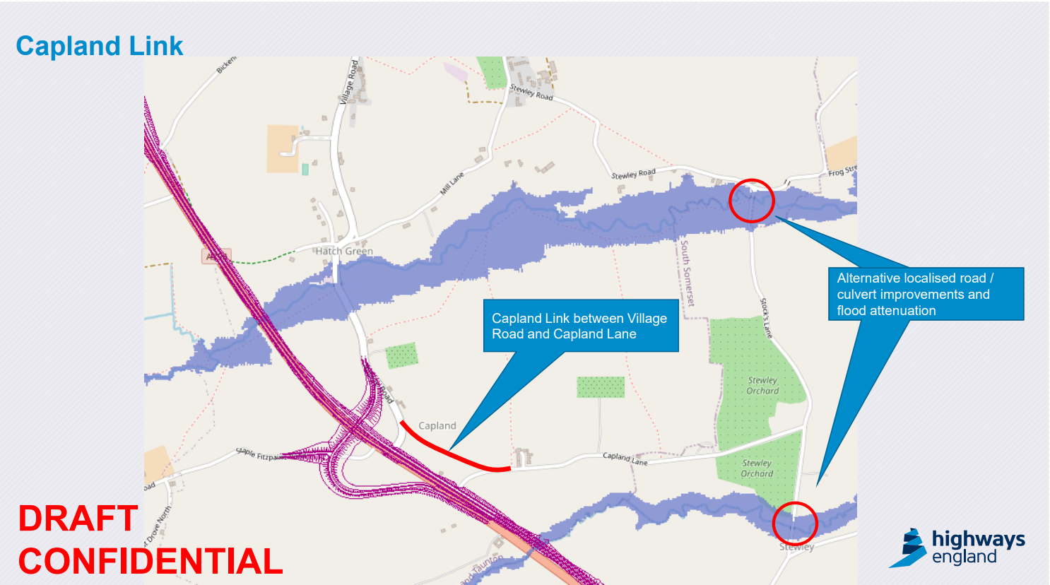

Slide 15
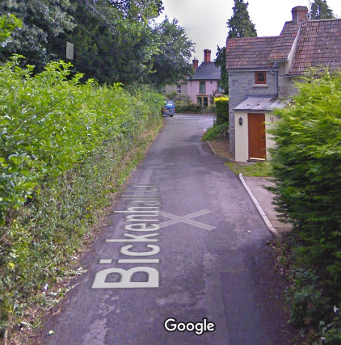
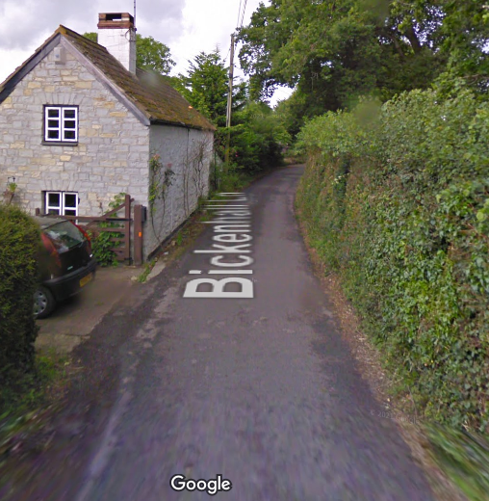
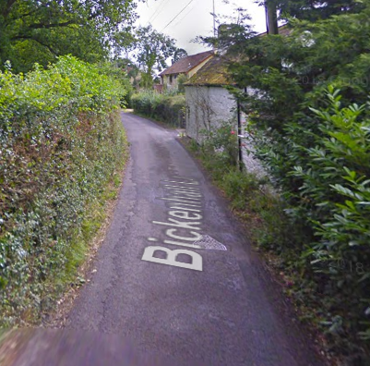
(1)
Traffic from Staple Fitzpaine, Curland, New Town and Bickenhall areas will use this new Bickenhall Lane bridge enroute to and from Mattock’s Tree Green junction. The National Highways analysis of the impact of this traffic is wrong, as it made a basic arithmetical error in it summations. The consequence of this bridge over the Expressway will be 600-700 more vehicles a day passing along the narrow Lane and the centre of Hatch Beauchamp, passing the village green, children’s play park and a large care home. As the Google Streetscene photographs show, the lane is narrow and totally unsuitable for this traffic, which will include large milk lorries, delivery lorries, large farm machinery, besides normal residential vehicles. It is for these reasons that the Community Mitigation Proposals included a requirement for direct access to the new A358 south of Hatch Beauchamp. Moreover, without this access additional traffic will also travel along Village Road South enroute to and from Mattock’s Tree Green junction, adding to the traffic from Bickenhall Lane. In all some 800-900 extra vehicles movements will occur through Hatch Beauchamp centre and Village Road North. To mitigate this adverse impact two alternative proposals have been submitted to National Highways.

Slide 16
(2) The first assumed the Bickenhall overbridge was not present. As Bickenhall Lane is a busy local route favoured by farm traffic and lorries, the lane needs to be kept open by extending the planned service road from Ashill to Hatch Beauchamp overbridge to Bickenhall Lane. A taper merge slip road access should be provided onto the westbound carriageway at the western end of this extended service road. Furthermore, as slow moving traffic will be permitted on the dual carriageway the need for a bridge to accommodate all traffic is removed.

Slide 17
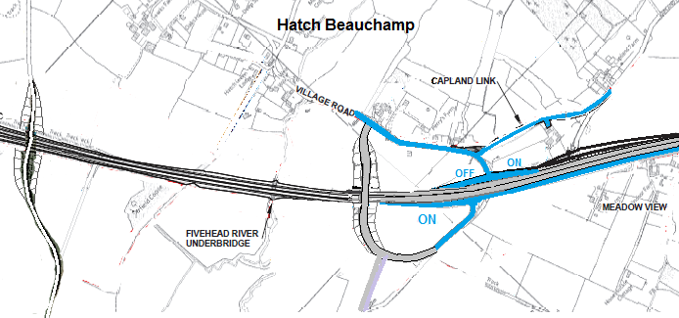
(3) The second proposal assumed the bridge is built. The western end of the service road should terminate at the existing Staple Fitzpaine junction, from which point a CD 122 Layout A Option 1 taper merge slip road should be provided onto the westbound carriageway. The service road with this on-slip enables traffic from Kenny, Wood Road, Folly Drove, Meadow View, Staple Fitzpaine Road and Hatch Beauchamp Village Road to efficiently access the westbound carriageway. Highways England’s 2017 traffic data indicated some 2500 vehicles accessed the existing A358 from roads leading into the scheme’s service road. This local traffic, which will continue to grow, must retain access to the new A358 rather than the scheme route via Hatch Beauchamp to Mattock’s Tree Green junction and Ashill to Ashill junction.
Closed
Bickenhall Lane Overbridge
Closed
Closed
Service road is existing A358 to Staple Fitzpaine Road
Parish Proposals in BLUE*

Slide 18
Consultation closes 11.59pm on 22 November
All comments and views are valid.
If you’ve talked to me about them, or your neighbour, spouse etc then that’s what you put in your submission.

Slide 19
Help for completing forms will be available at Produce Market on 13 November and afternoon of 20 November in Village Hall

